Slide 1


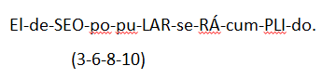
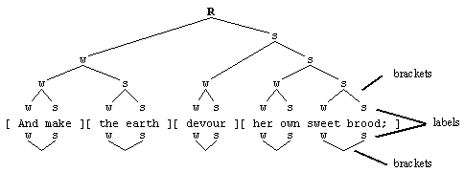
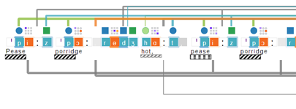

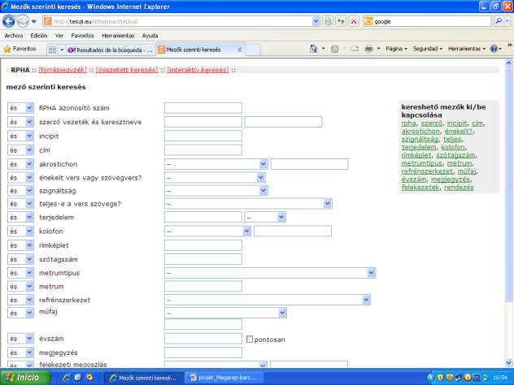
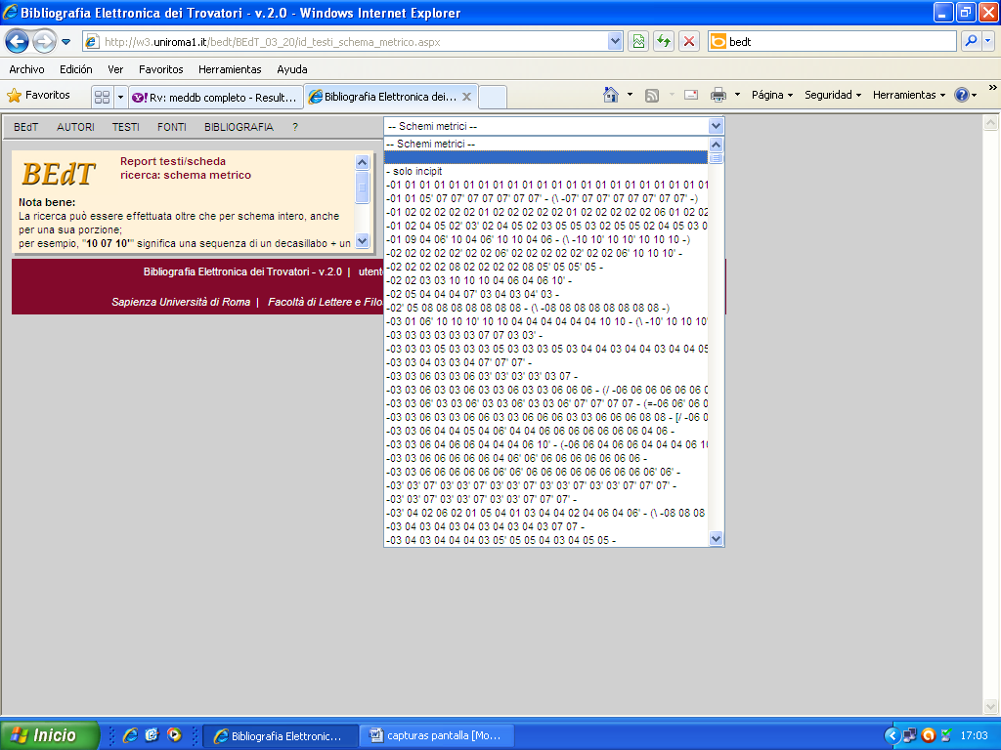
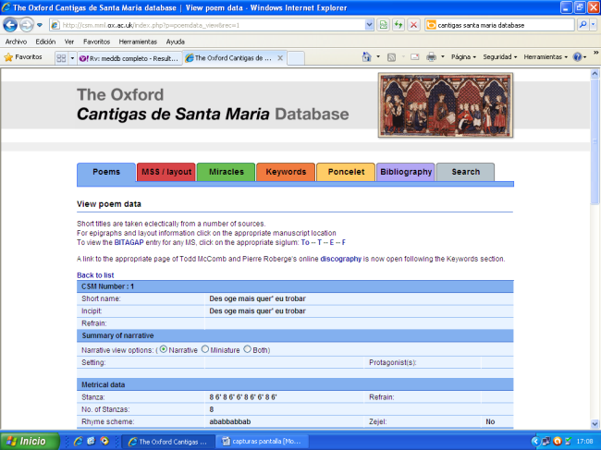
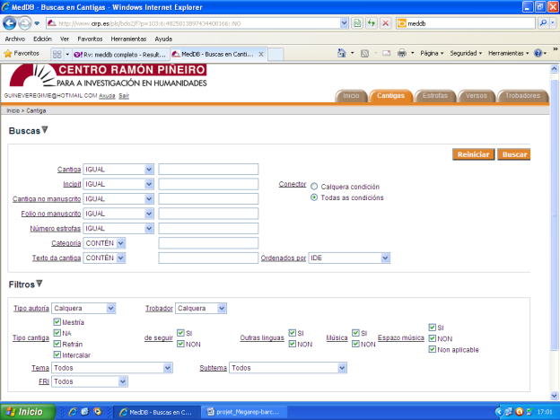
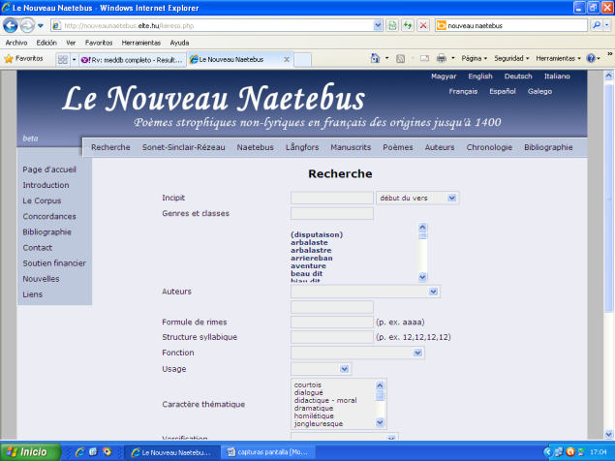
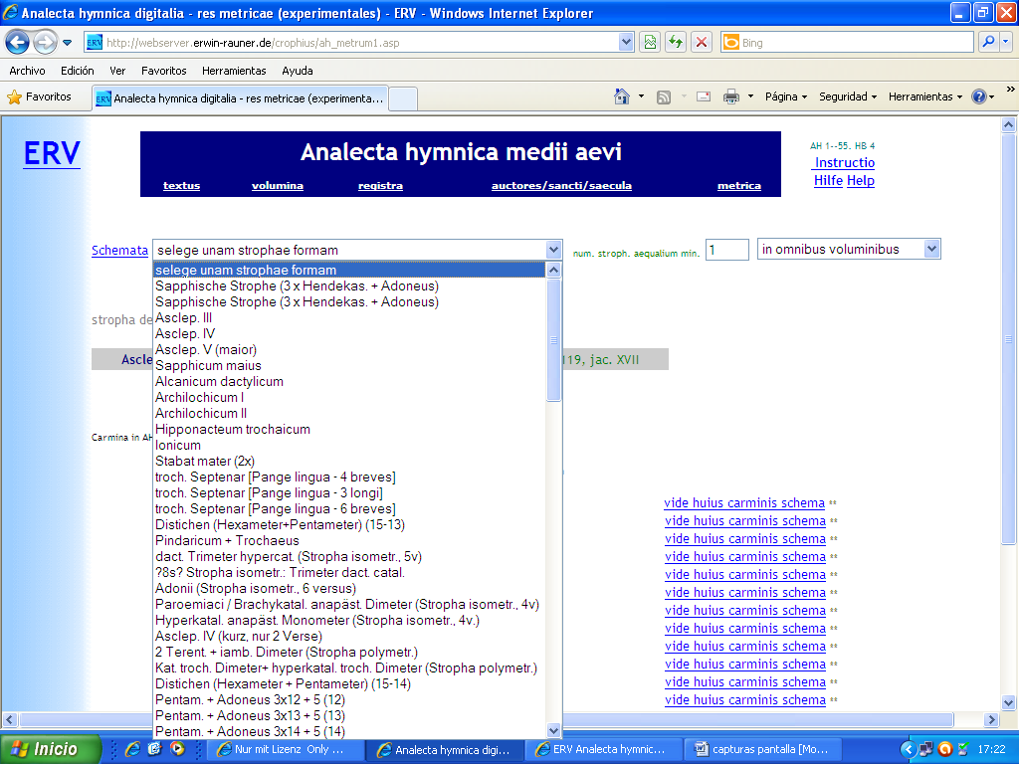


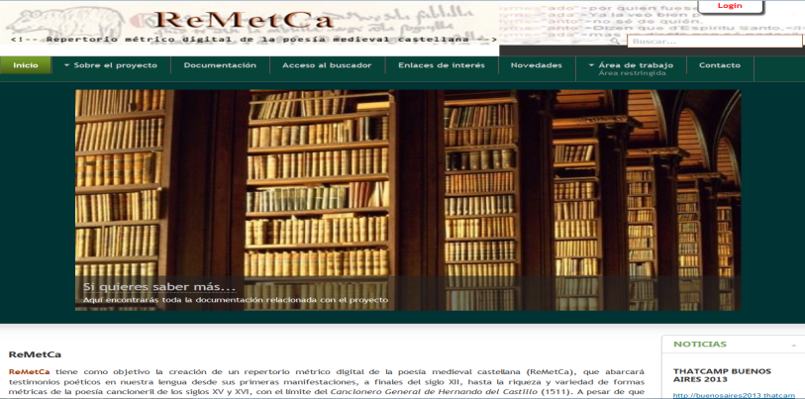
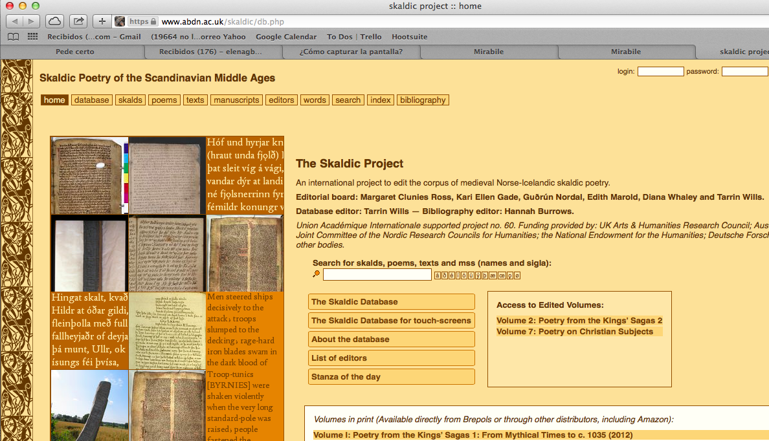
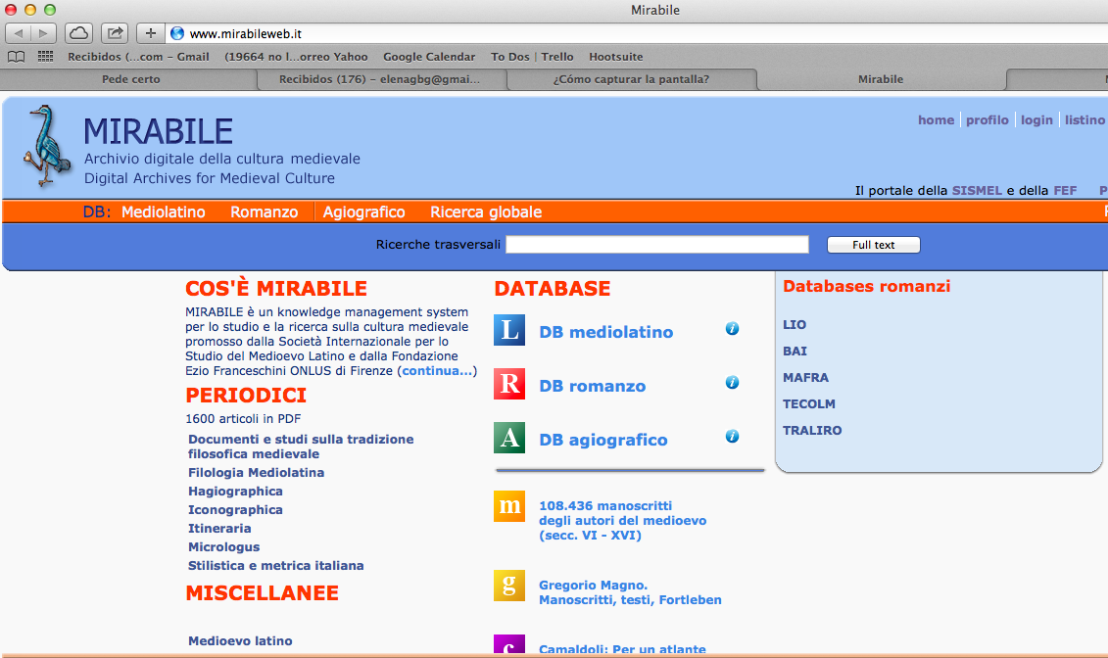





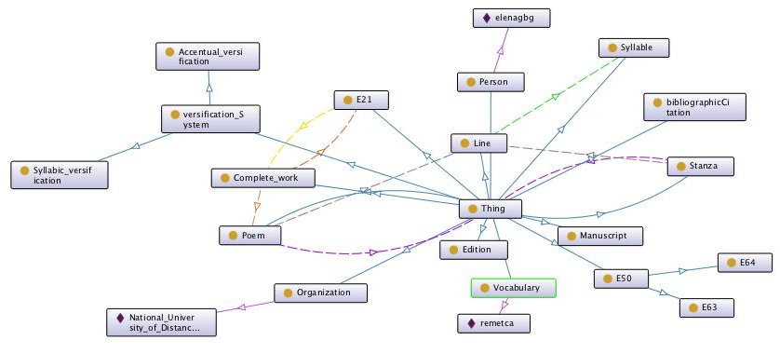







Linked Open Data to represent multilingual poetry collections.
A proposal to solve interoperability issues between poetic repertoires
Elena González-Blanco¹ | Gimena del Río² | Clara I. Martínez Cantón¹
1 | Universidad Nacional de Educación a Distancia (UNED, Spain) 2 | Consejo Nacional de Investigaciones Científicas y Técnicas (CONICET, Argentina)
How to encode poetry?
State of the Art of digital poetry: lack of standardization
Heterogeneous theoretical traditions
Heterogeneous repertoires and databases
Why?
Common conceptualization
Based on metadata added to existing databases
Not altering the internal structure of each repertoire
Code is published as linked data available on the web
Extensible and flexible model
RPHA - Hungary
BedT - Italy
Cantigas Oxford
Our poetic ontology proposal
Based on:
Remetca Repertoire
Common fields of other repertoires
Re-Using:
The CIDOC Conceptual Reference Model (CRM)
XML-TEI Tags for poetry and metrics
DublinCore
Other standards and vocabularies
First published in:
http://datahub.io/dataset/ReMetCa-ontology
http://lov.okfn.org/dataset/lov/vocabs/ReMetCa
Structured in:
MedDB2 – Galicia
Naetebus - France
Analecta Hymnica Latin
ReMetCa - Spain
Skaldic - Scandinavia
Mirabile - Italia
Existing projects = heterogeneous technology
Different structure and levels of complexity
Different content (by kind, time period, etc)
Different technological systems:
      SQL databases
      Proprietary RDBMS systems
      XML tagged text
Different levels of access
Our purpose
Interconnect and reuse data disseminated across existing poetic repertoires to make it easily retrievable
Our solution for interoperability and standarization
Publishing online repertoires in a structured format and by open standards in order to build an open-source and collaborative platform based on a poetic ontology which facilitates interoperability among the different European metrical repertoires
Combined with controlled vocabularies:
http://vocabularios.caicyt.gov.ar/pmc/
Conclusion
An ontology as a solid semantic structure as a basis to link the different poetic systems, not just a repository of datasets, thesauri or controlled vocabularies.
Philological
POETIC
ONTOLOGY
Technological
Building a conceptual model = ontology
Which includes…
  Metadata
  Vocabularies
  Properties
  Relations
If you want to know more…
egonzalezblanco@flog.uned.es
cimartinez@flog.uned.es
gdelrio.riande@linhd.uned.es
Acknowledges to MINECO EUIN2013-50630: “Repertorio Digital de Poesía Europea” (DIREPO) and FFI2014-57961-R. “Laboratorio de Innovación en Humanidades Digitales” and the Starting Grant ERC-2015-STG-679528 POSTDATA.

